Slide 1
ORuML: Optimised Routing in Wireless Networks using ML
Group Members:
1. Anjaneya Tripathi - 106118010
2. Isha Waghulde - 106118040
3. Khushali Patel - 106118044

Slide 2
TABLE OF CONTENTS
01
04
02
05
03
06
Introduction
Proposed Methodology
A brief overview of keywords and concepts
The skeleton
Problem Statement
Experimental set-up
What problem does the paper propose to solve
Set the table for the meal
Motivation
Mathematical Representation
The motivation behind the paper
Code and More

Slide 3
INTRODUCTION
This paper proposes an algorithm for a wireless network called Optimized Routing in wireless networks using Machine Learning (ORuML), which uses machine learning algorithm namely, K-nearest neighbor (KNN), Support Vector Machine (SVM), and Multinomial Logistic Regression (MLR), to predict the network type of the source and destination nodes.

Slide 4
NETWORK TYPES
Bluetooth
MANET
DTN
Transfer data over short distances
Self configured, self healing network
Transmit information in challenging environments

Slide 5
PROBLEM STATEMENT
When the data are transferred from a source node to a destination node, there are various intermediate nodes that help in transfer of messages. Therefore, the selection of such nodes is necessary for successful and on time delivery of data.

Slide 6
MOTIVATION
The delivery of a message is very important in areas like disaster prone areas where when some disaster occurs, the affected people need to get help immediately and as per their needs without any delay by delivering a message via optimized path.

Slide 7
PROPOSED METHODOLOGY

Slide 8
SEGMENTS
Dataset Collection & Cleaning
Network ID
Class of node
The dataset and its description
Finding network ID from the IP address
Classify nodes according to their class
Classification
Bluetooth
Trust Factor
Classify the nodes by their type using the models
Bluetooth provides direct transfer
How reliable is this node?

Slide 9
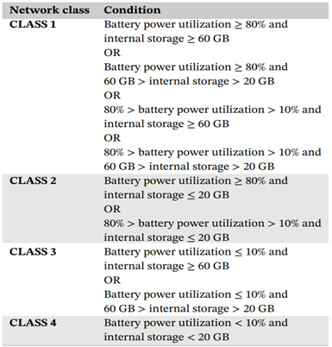


Slide 10
EXPERIMENTAL SET-UP
01
02
03
Dataset Description
Columns and their repercussions
Data Cleaning
Dropping columns, Random Oversampling
Machine Learning Models
SVM, KNN, MLR

Slide 11
OUR MODELS
SVM
KNN
MLR
The Support Vector Machine algorithm and its accuracy
The K nearest neighbour algorithm and its accuracy
The Multinomial Logistic Regression algorithm and its accuracy

Slide 12
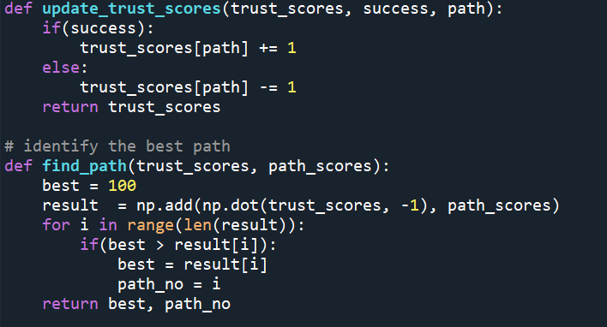
MATHEMATICAL REPRESENTATION
The code logic, flow and output!

